Slide 1
Deep Learning: RNNs
Recurrent Neural Networks
Notes:
Welcome to our discussion on Recurrent Neural Networks, a crucial deep learning technique for handling sequential data. Explain the importance of RNNs in processing time-series data, speech recognition, and natural language processing. Ask students if they have encountered any applications of RNNs in their daily lives.

Slide 2
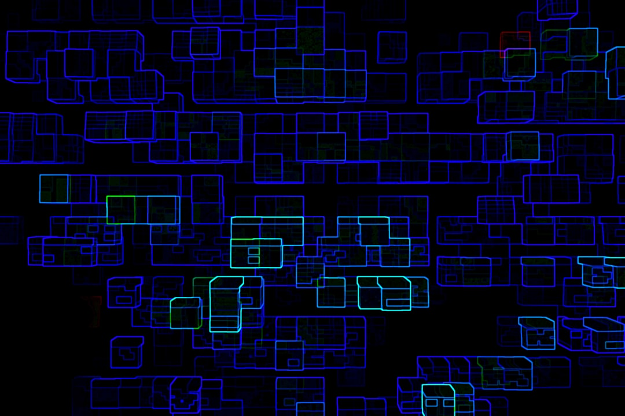
Intro/Background: Importance of RNNs
Handle sequential data with temporal relationships
Capture contextual information in speech and text
Enable real-time forecasting and prediction
Support natural language processing tasks
Improve speech recognition systems
Enhance machine translation capabilities
Facilitate sentiment analysis and opinion mining
Enable time-series forecasting and anomaly detection
Support recommender systems and personalized marketing
Notes:
Discuss the significance of RNNs in various applications, such as speech recognition, natural language processing, and time-series forecasting. Provide examples of how RNNs can be used to improve these tasks, and ask students to think of potential use cases in their own projects. Emphasize the ability of RNNs to capture contextual information and handle sequential data.

Slide 3
Architecture
Input gate controls information flow
Output gate generates predictions
Cell state retains internal memory
Hidden state captures sequential context
y = sigmoid(Wx + Uh)
Notes:
Explain the basic architecture of RNNs, highlighting the input gate, output gate, cell state, and hidden state. Discuss how these components interact to process sequential data. Use the equation y = sigmoid(Wx + Uh) to illustrate the simple RNN equation, and ask students to consider how this equation is used in practice. Image query: simple RNN architecture diagram.

Slide 4
Variants
LSTM (Long Short-Term Memory) networks
GRU (Gated Recurrent Unit) networks
Bidirectional RNNs for sequential data
Depth-gated RNNs for improved performance
Residual connections for vanishing gradients
Attention mechanisms for focused processing
Convolutional RNNs for spatial-temporal data
Recurrent Highway Networks for deep architectures
Clockwork RNNs for multi-scale processing
Notes:
Discuss various RNN variants, such as LSTMs and GRUs, and their strengths and weaknesses. Explain how these variants address specific challenges, like vanishing gradients or sequential data processing. Ask students to consider which variant might be most suitable for a particular application, and provide examples of successful deployments. Emphasize the importance of selecting the right RNN variant for a specific task.

Slide 5
Applications + Advantages/Limitations
Speech recognition and voice assistants
Natural language processing and machine translation
Time-series forecasting and anomaly detection
Sentiment analysis and opinion mining
Recommender systems and personalized marketing
Advantages: handle sequential data, capture context
Limitations: vanishing gradients, slow training
Real-time forecasting and prediction capabilities
Improved accuracy with pre-trained models
Notes:
Explore various applications of RNNs, highlighting their advantages and limitations. Discuss how RNNs can be used for speech recognition, natural language processing, and time-series forecasting, among other tasks. Emphasize the benefits of using RNNs, such as their ability to handle sequential data and capture contextual information. Also, address the challenges associated with RNNs, like vanishing gradients and slow training, and ask students to think of potential solutions.

Slide 6
Summary
Handle sequential data with temporal relationships
LSTM (Long Short-Term Memory) networks
Speech recognition and voice assistants
Notes:
Summarize the key takeaways from the discussion on RNNs, highlighting their importance in handling sequential data and capturing contextual information. Emphasize the strengths and weaknesses of RNNs, as well as their various applications and real-world deployments. Ask students to reflect on what they have learned and consider potential future directions for RNN research and development. Provide examples of how RNNs can be used in practice, and encourage students to explore these topics further.

